Slide 1
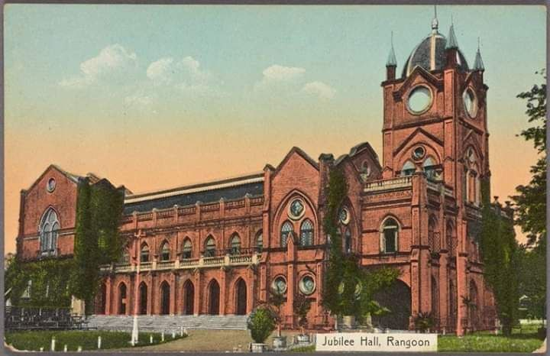
Jubilee Hall
Presented by Group-3

Slide 2
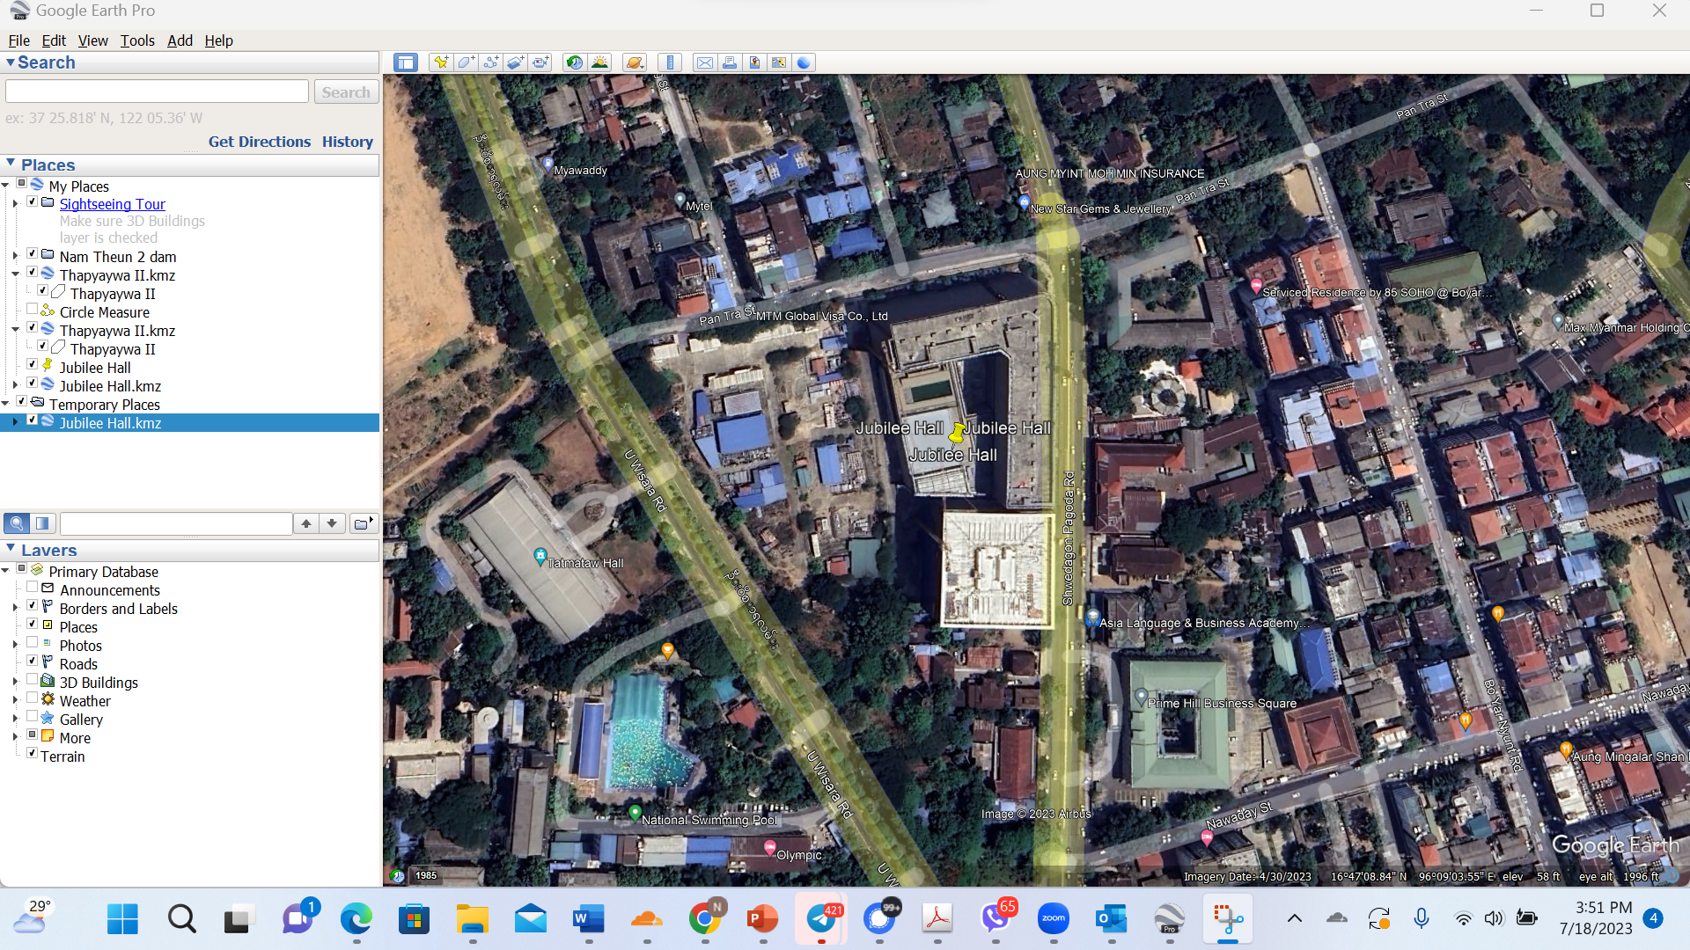
Location
- located on Shwedagon Pagoda Road in Dagon Township, 16.784921°N 96.152521°E

Slide 3
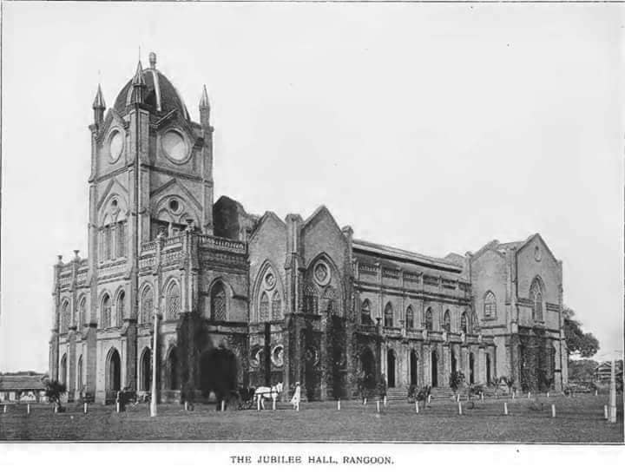
Timelines
-previously occupied by a complex of wooden assembly rooms used by the British administration.
-40 Over the years, 1897 transformed into the Jubilee Hall to mark the 60th anniversary of the queen’s coronation.
-managed by Rangoon municipality.
-hosted events such as a meeting of British government officials ( opening of Yangon Zoo, arts-and-crafts shows, talks, ordination ceremonies, wedding receptions, charity shows to raise funds to help Britain fight World War I.
-served as a gathering place for the powerful, educated, and wealthy elite.
-After 1948, continued to be used for educational purposes and various public events.
-demolished in 1985 to eliminate many factors

Slide 4
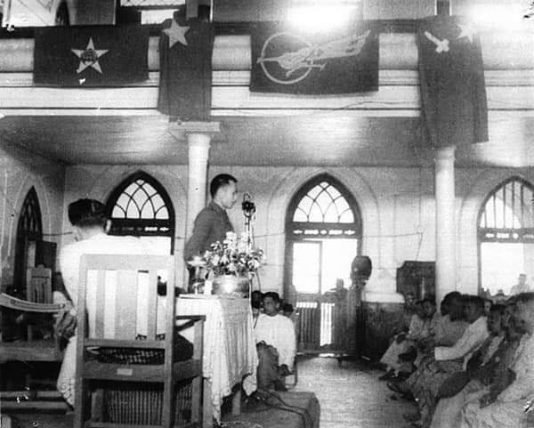
First Constution
1947 the building hosted the Anti-Fascist People’s Freedom League convention, during which Aung San drafted Burma's first constitution.[

Slide 5
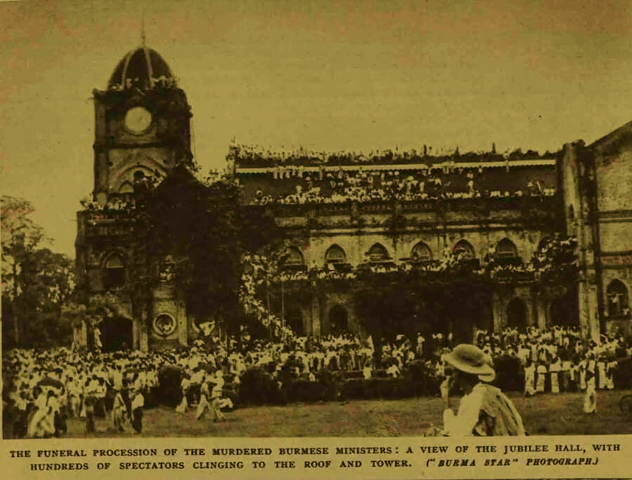
State Funeral
On 19th July 1947, after the assassination of General Aung San and his political mates, their bodies were placed in Jubilee Hall for people to come and pay respect.
A state funeral for Myanmar independence hero General Aung San and eight of his colleagues was held on tomorrow 76 years ago.
Their bodies had lain in state for more than eight months at the Jubilee Hall

Slide 6
Values
Remembrance
Jubilee Hall
Historical Value
Political Value
Spiritual Value

Slide 7
References
1.Bo Bo, ဘတ်စ်ကားစီးပြီး ရုံးတက်တဲ့ ဘိလပ်ပြန် ညွှန်ကြားရေးမှူးချုပ်, BBC Burmese News,
18 September 2020
https://www.bbc.com/burmese/in-depth-54130519
2. lostfootsteps.org,
https://lostfootsteps.org/my/history/jubilee-hall
3. Kyaw KoKo, အဖျက်ဆီးခံ သမိုင်းဝင်ဂျူဗလီဟော နှင့် အကျိုးစီးပွားအတွက် Y-Complex,27 June 2020,Mizzimaburmese
https://www.mizzimaburmese.com/article/71059
4. Jubilee Hall Postcard, SMITH COLLECTION/GADO
5.mdn.gov.mm, Dec 22 2019
ဗိုလ်ချုပ်အောင်ဆန်း၏ ၁၉၄၇ ခုနှစ်၊ မေလ ၁၉ ရက်နေ့တွင် ဂျူဗလီဟောပဏာမပြင်ဆင်မှုညီလာခံတွင် မိန့်ကြားခဲ့သည့် မိန့်ခွန်းမှ ကောက်နုတ်ချက်
6. people-garden.blog.spot.com,
September 17,2012,
Jubilee Hall မှာ ဖဆပလညီလာခံမိန့်ခွန်းပြောနေတဲ့ဗိုလ်ချုပ်,
http://people-garden.blogspot.com/2012/09/blog-post_9059.html?m=1
7. Video Credit to MRTV-Film and Documents Archive
8. တိုက်စိုး, ဂျူဗလီဟောမြင်ကွင်း , ဩဂုတ်, ပထမအကြိမ်, 1970

