Slide 1
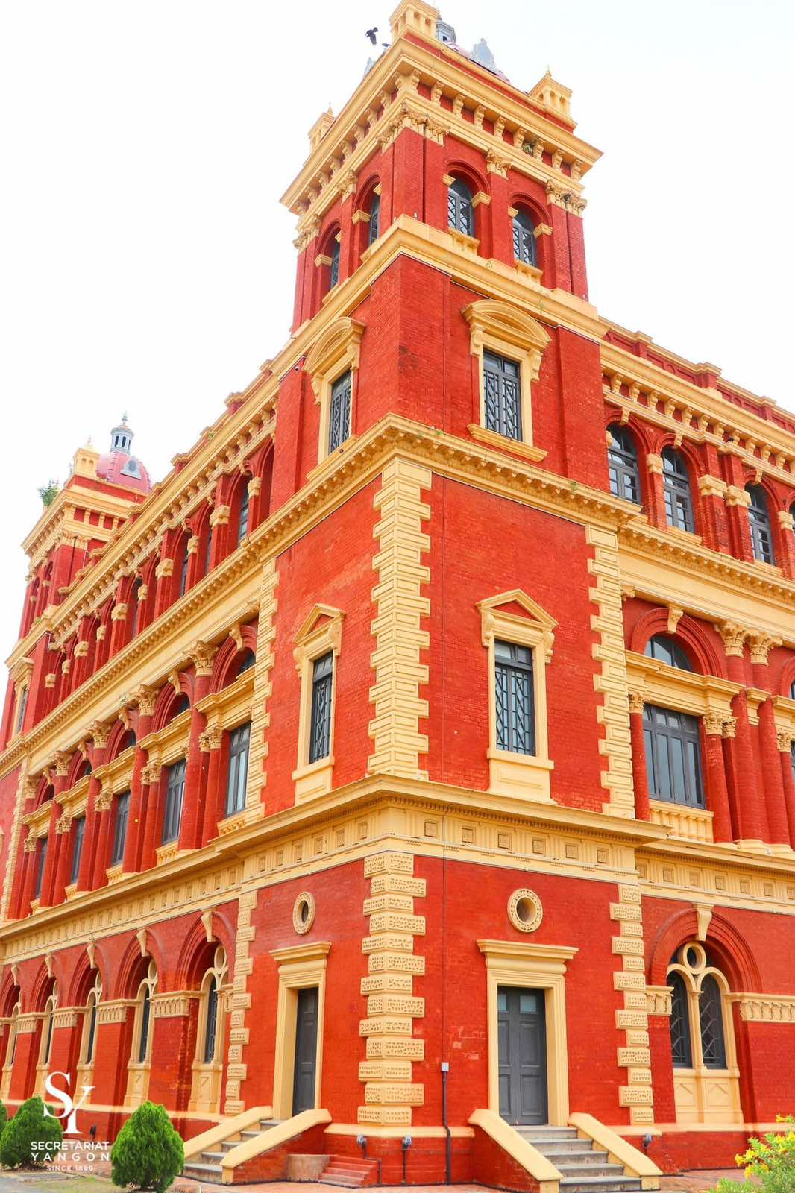
The Secretariat,
Minister’s Building
Group 1 – Esther Winston, SSM-13406, Nway Oo 8

Slide 2
                CONTENT
          The Secretariat Building
          Historical Timeline
          Secretariat Building Structure
          Current day Secretariat Building
          What to RE:member?

Slide 3
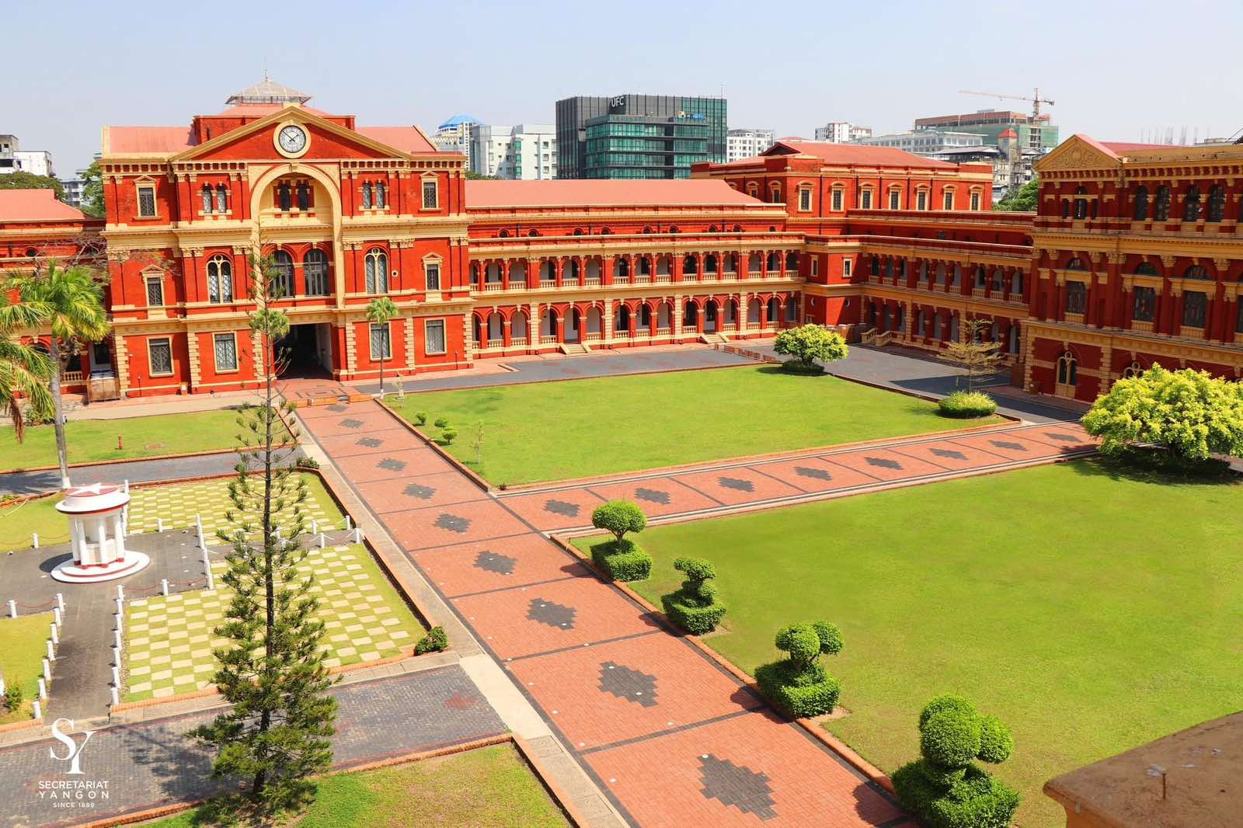
The Secretariat Building
Built in several stages between 1889 and 1905. Victorian style ancient building with a history of 130 years.
Administrative center of British Burma during colonial era.
1938, a student named Bo Aung Kyaw was killed on the street west of the Secretariat building during protest demanding the release of anti-British activists. Hence, the street is called Bo Aung Kyaw street in current days.
In 1947 July 19th, the Secretariat witnessed the modern Burma’s nightmare. Independence Leader General Aung San along with other country’s important decision makers were assassinated in the Secretariat building.

Slide 4
THE HISTORICAL TIMELINE

Slide 5
The Historical Time line
Colonial Era (1824 – 1948)
Pre-Independence Era (1946-1947)
Independence Era and
Coup Era (1948 – current day)
British colonization on Burma lasted from 1824 to 1948 successive three Anglo-Burmese wars.
The British introduced a radically different educational system from the traditional Sangha Education.
Ethnic minority communities benefited from British rule, and foreigners flooded the major cities in pursuit of opportunities under the Pax Britannica—a systematized, hegemonic international legal and maritime control system regulating trade across the empire.
General Aung San became head of the AFPFL in 1946.
He continued the more peaceful struggle for Burmese independence until his assassination after the overwhelming victory of the AFPFL in the April 1947 constituent assembly elections.
Burma finally became independent on 4 January 1948.
3 constitutions –
  1947 Constitution
  1974 Constitution
  2008 Constitution
3 Coups by Military Dictators
  Ne Win Era (1962-1981) ruling period 19 years
  Than Shwe Era (1992 – 2011) ruling period 18 years
  Min Aung Hlaing (2021 – Current)
Burma aka Myanmar citizen hasn’t enjoyed a period of peace and glory due to the greed of military dictators.

Slide 6
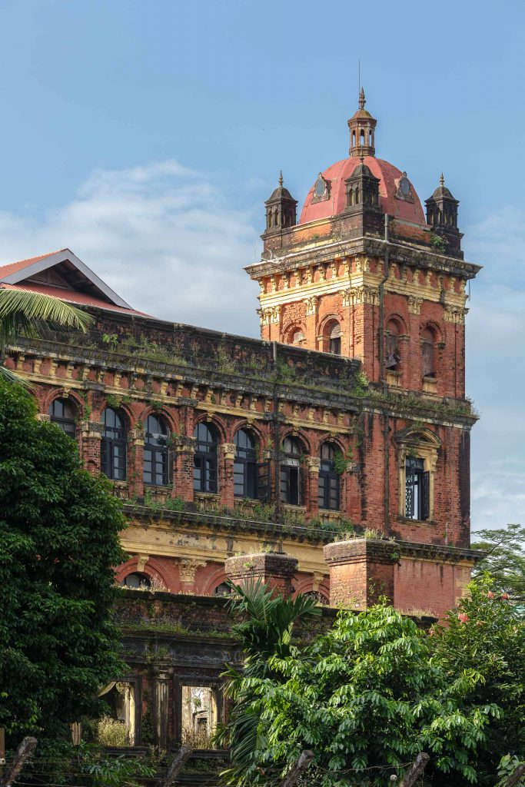
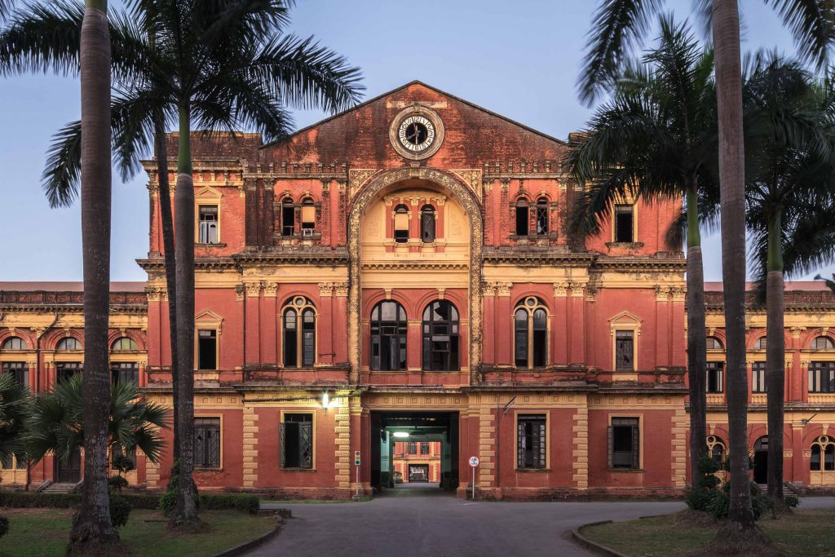
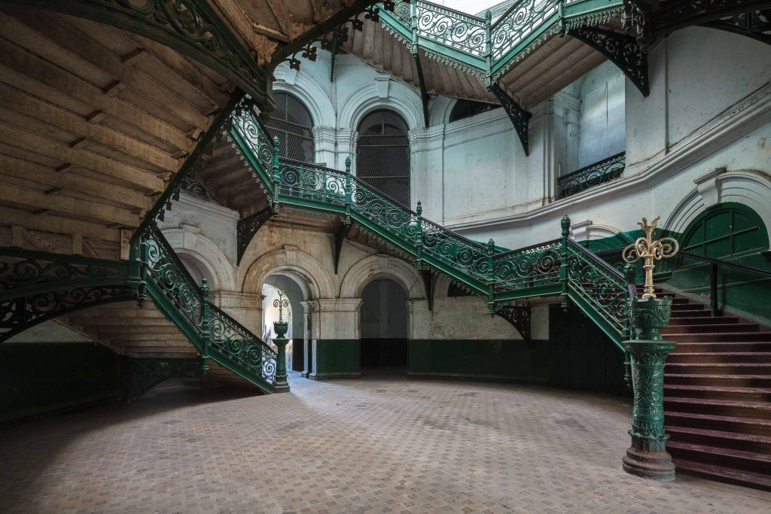
Before Renovation, the building reminds the endless mourning of Myanmar people over the loss of General Aung San and other ministers. The building was treated as a forgotten building during the first coup era also known as U Ne Win era ( 1962 – 1988). Thus, it becomes an abandoned space with no one to care for the magnificent ancient architecture.

Slide 7
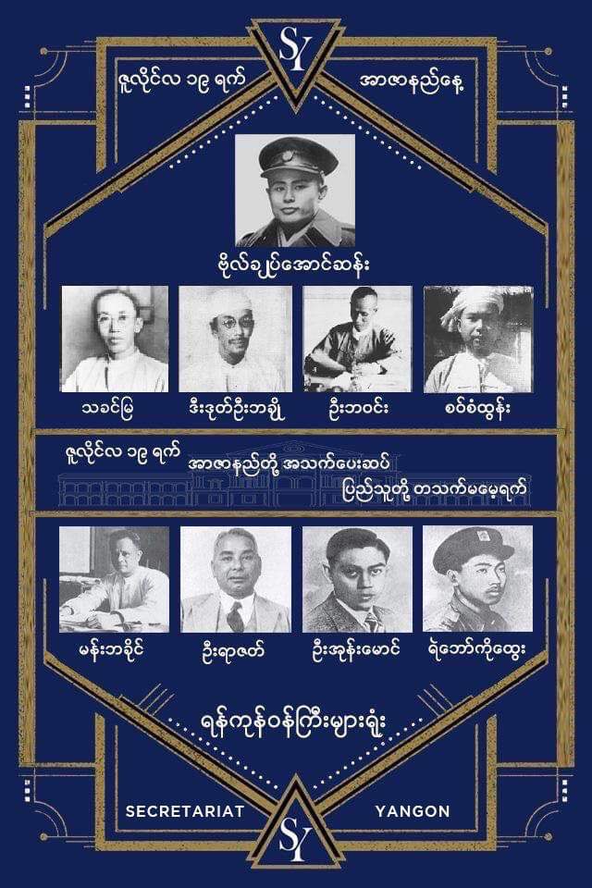
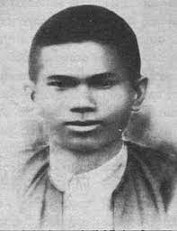
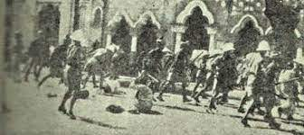
The Secretariat building witnessed the last moment of Independence Leader General Aung San along with his ministers.
The Secretariat building, even after renovation, always closes on the Martyr’s Day in remembrance of the tragic event.
Martyrs’ Day is a Burmese national holiday observed on 19 July to commemorate the nine Martyrs.
They are Gen. Aung San and seven other leaders of the pre-independence interim government, and one bodyguard.
Bo Aung Kyaw

Slide 8
SECRETARIAT BUILDING STRUCTURE

Slide 9
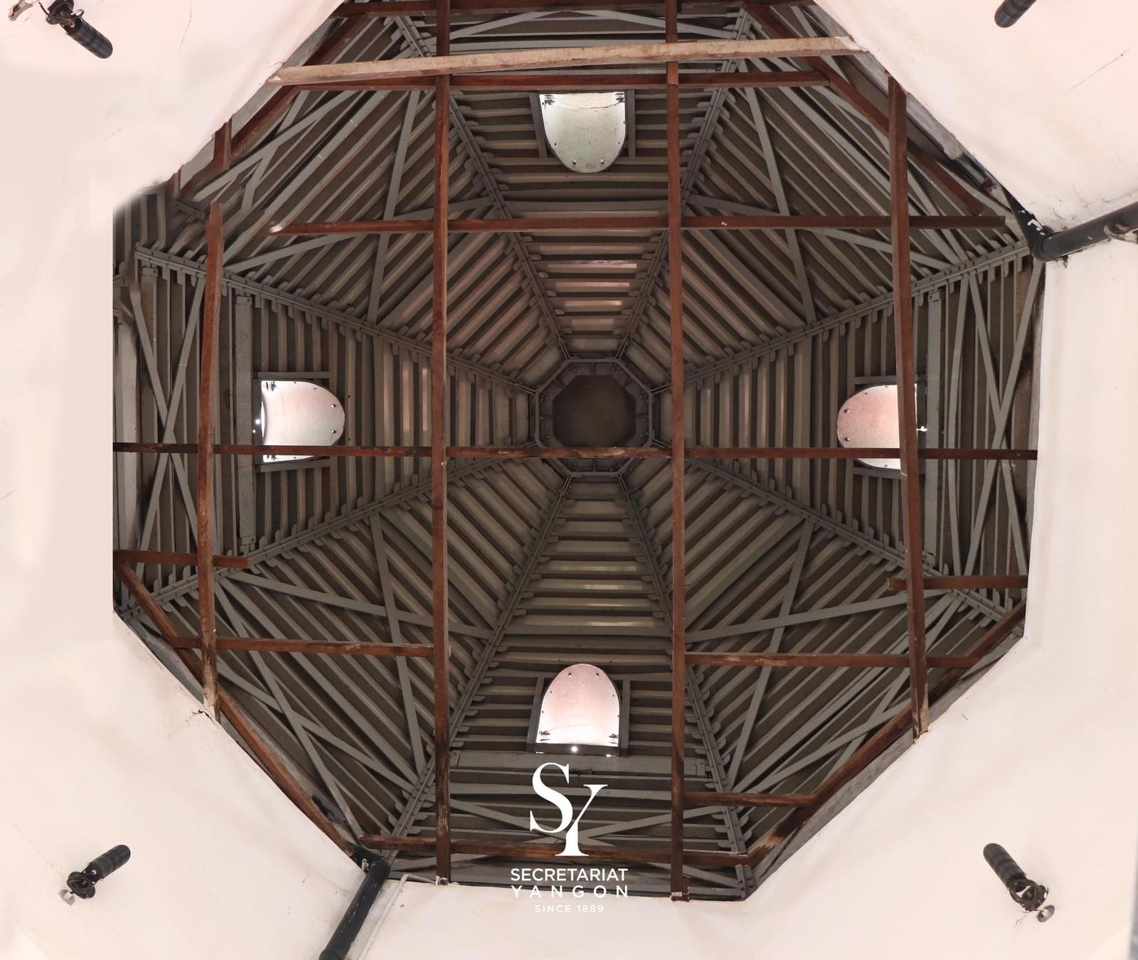
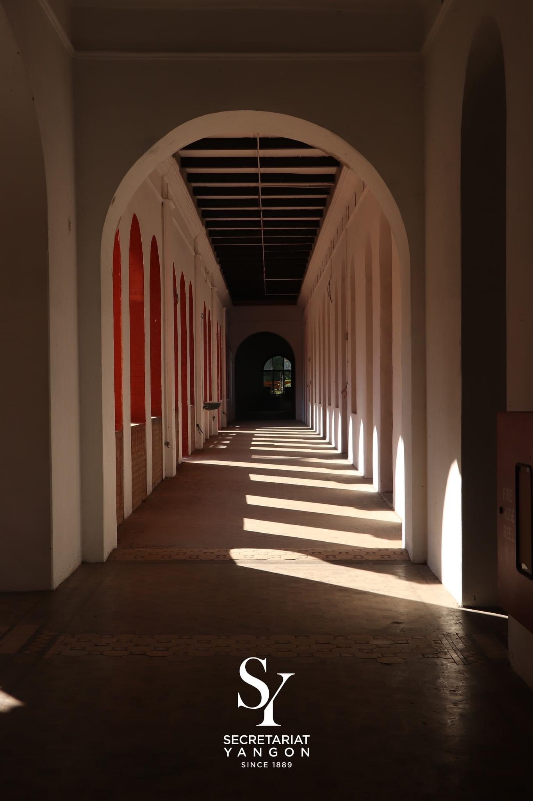
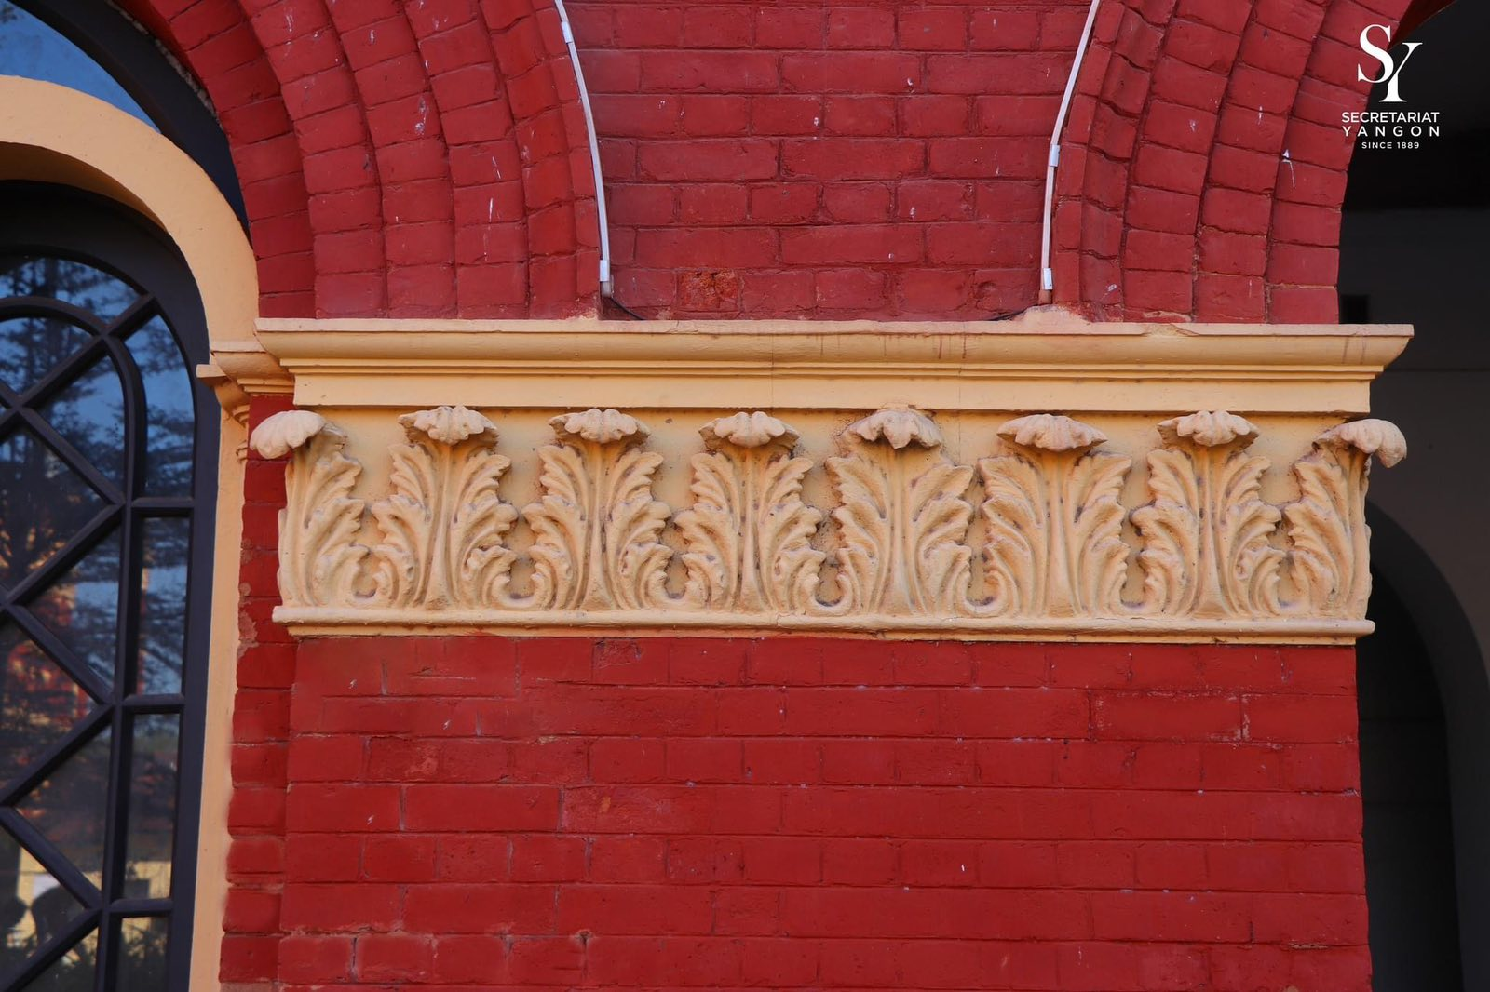
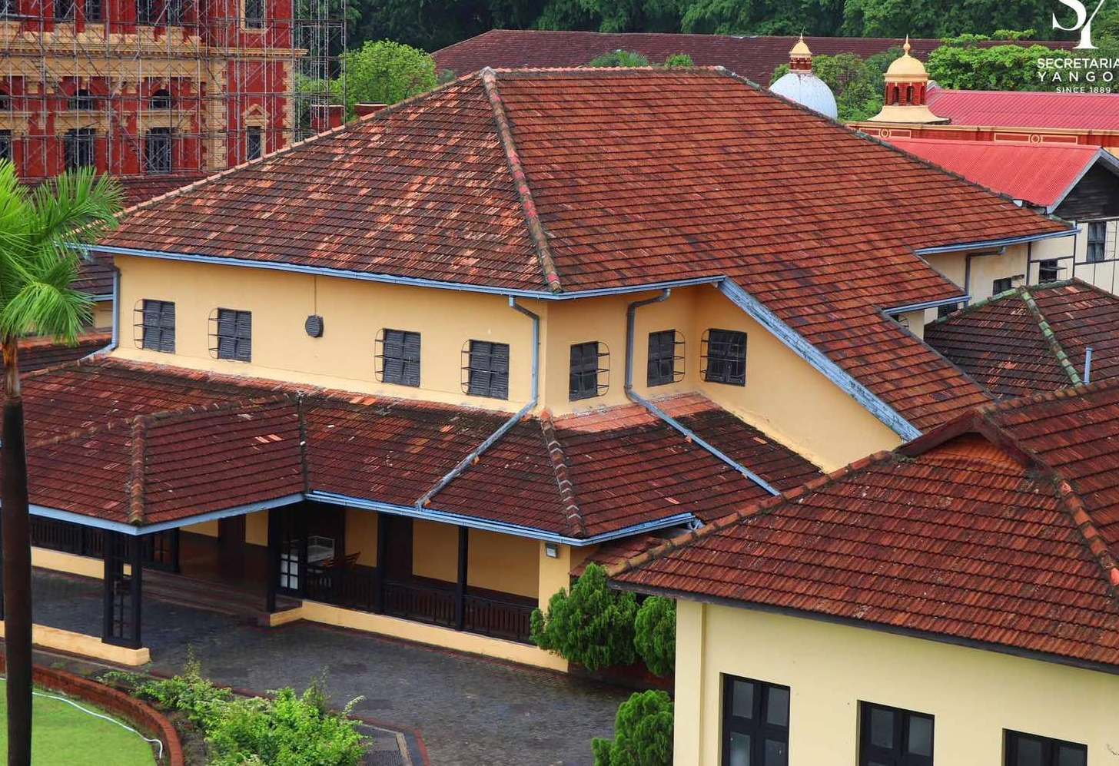
Load-bearing system
Lime casting and Masonry pointing
Dome Roof structure
Clay tile roof (Marseilles and Mangalore tiles)

Slide 10
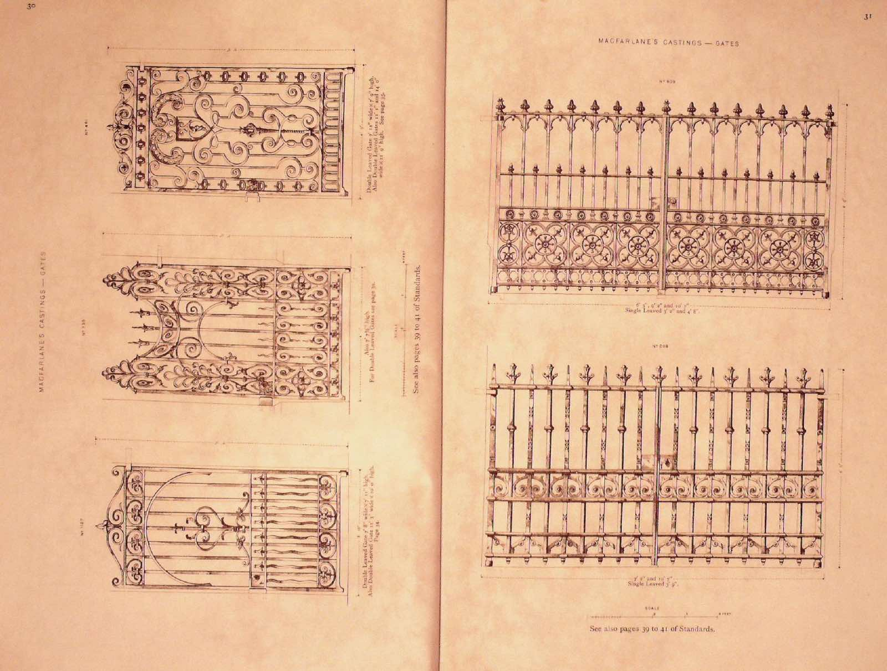
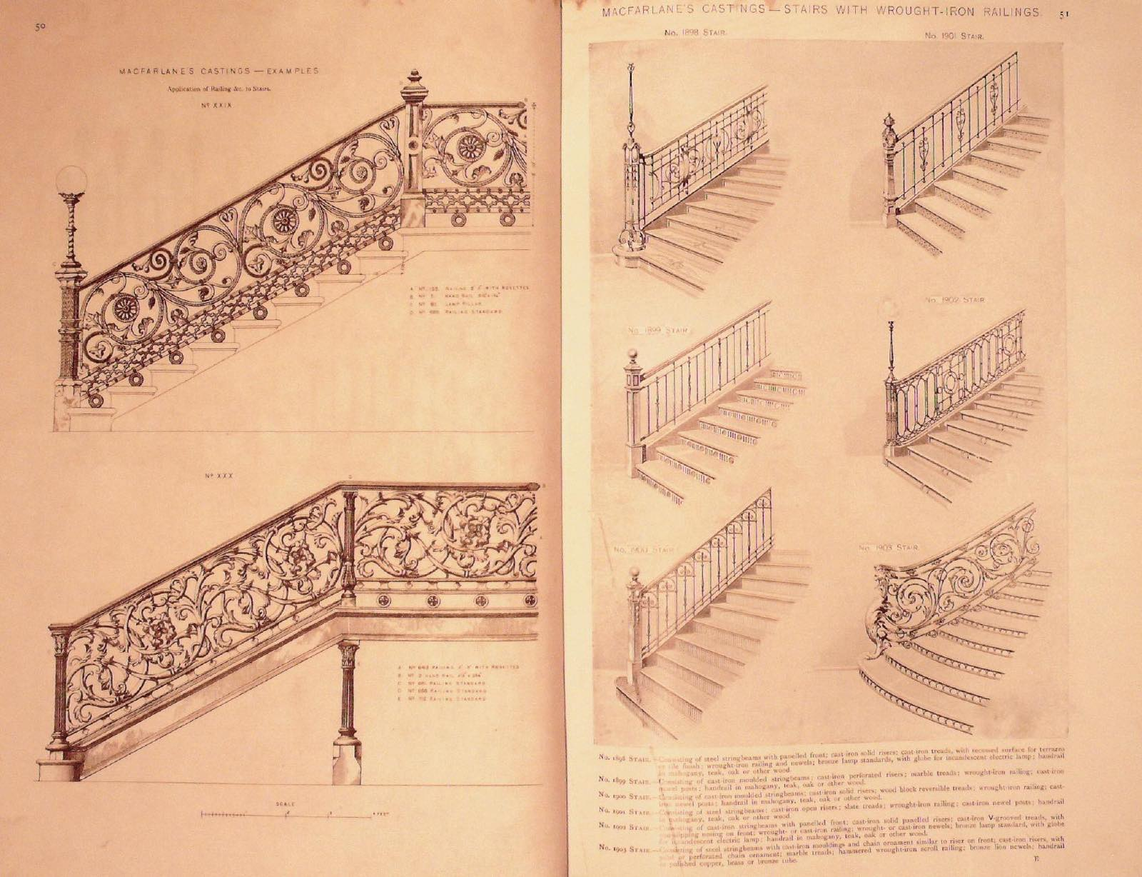
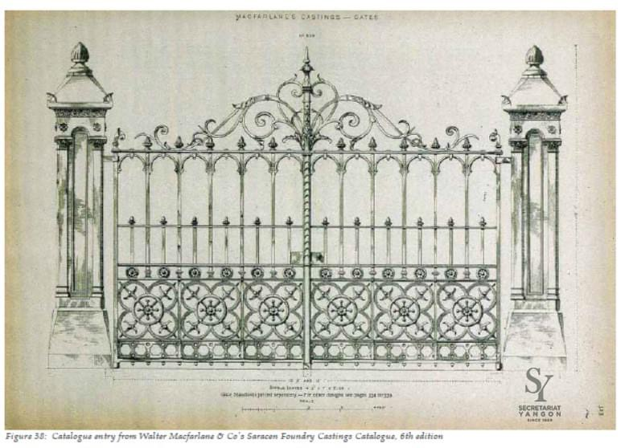
Cast iron design from WALTER MACFARLANE & Co.

Slide 11
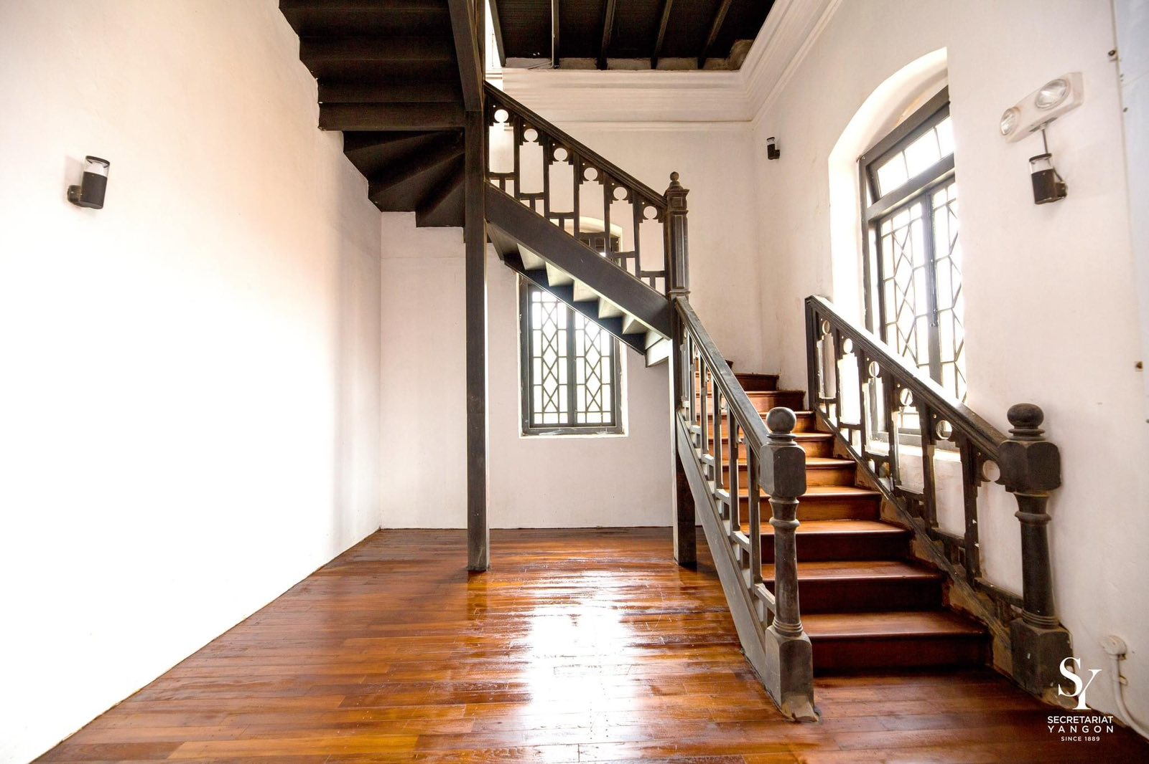
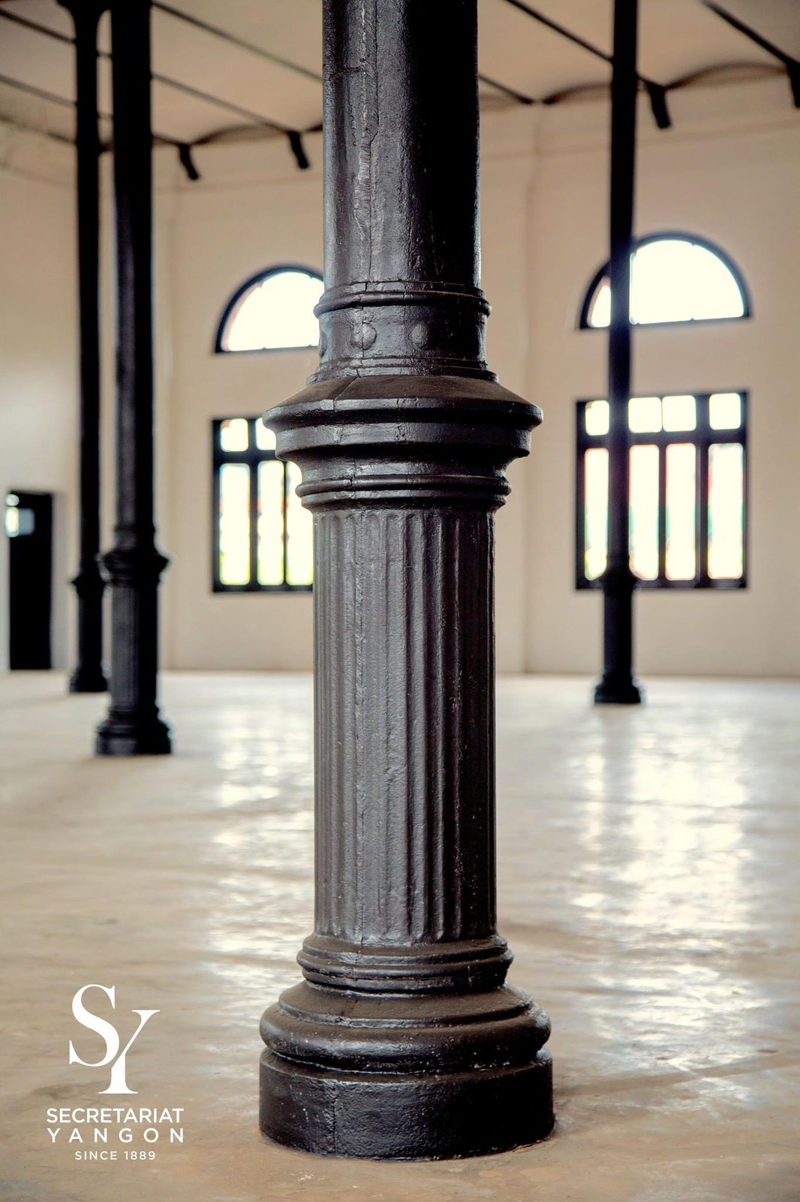
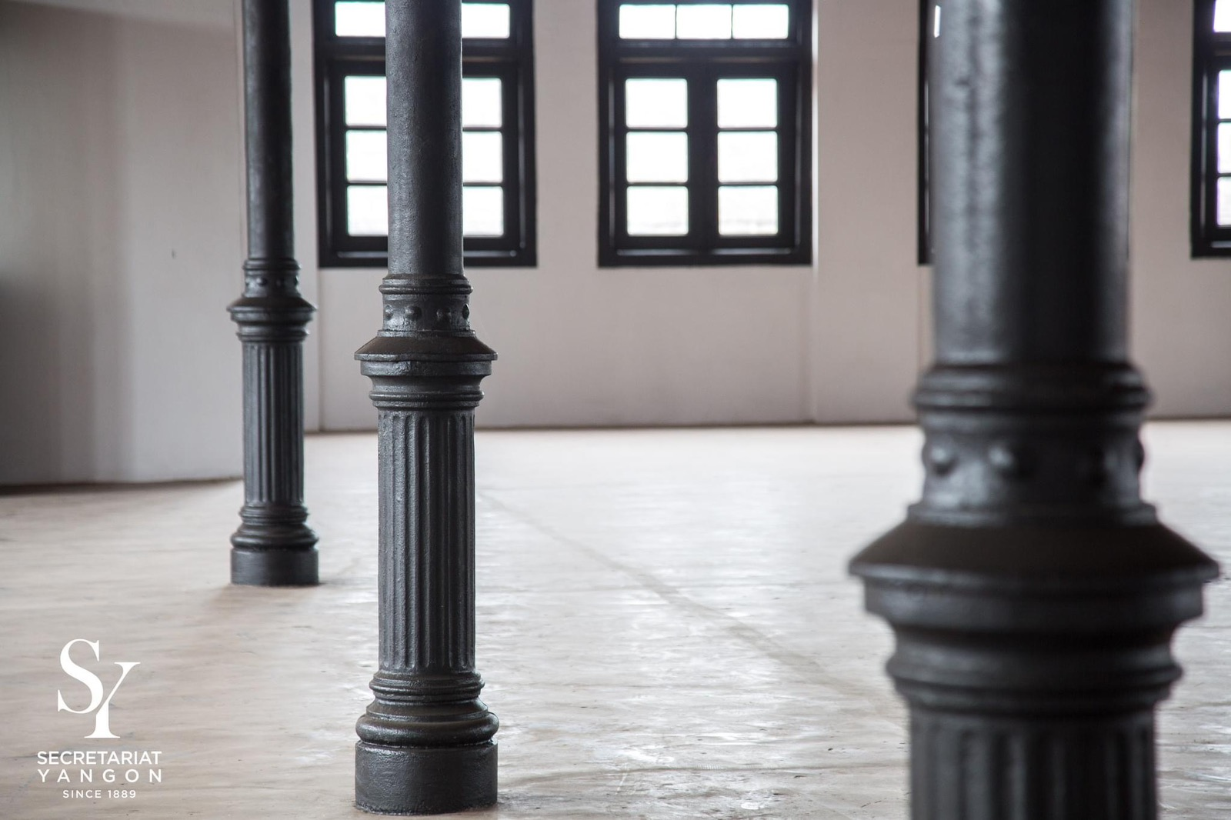
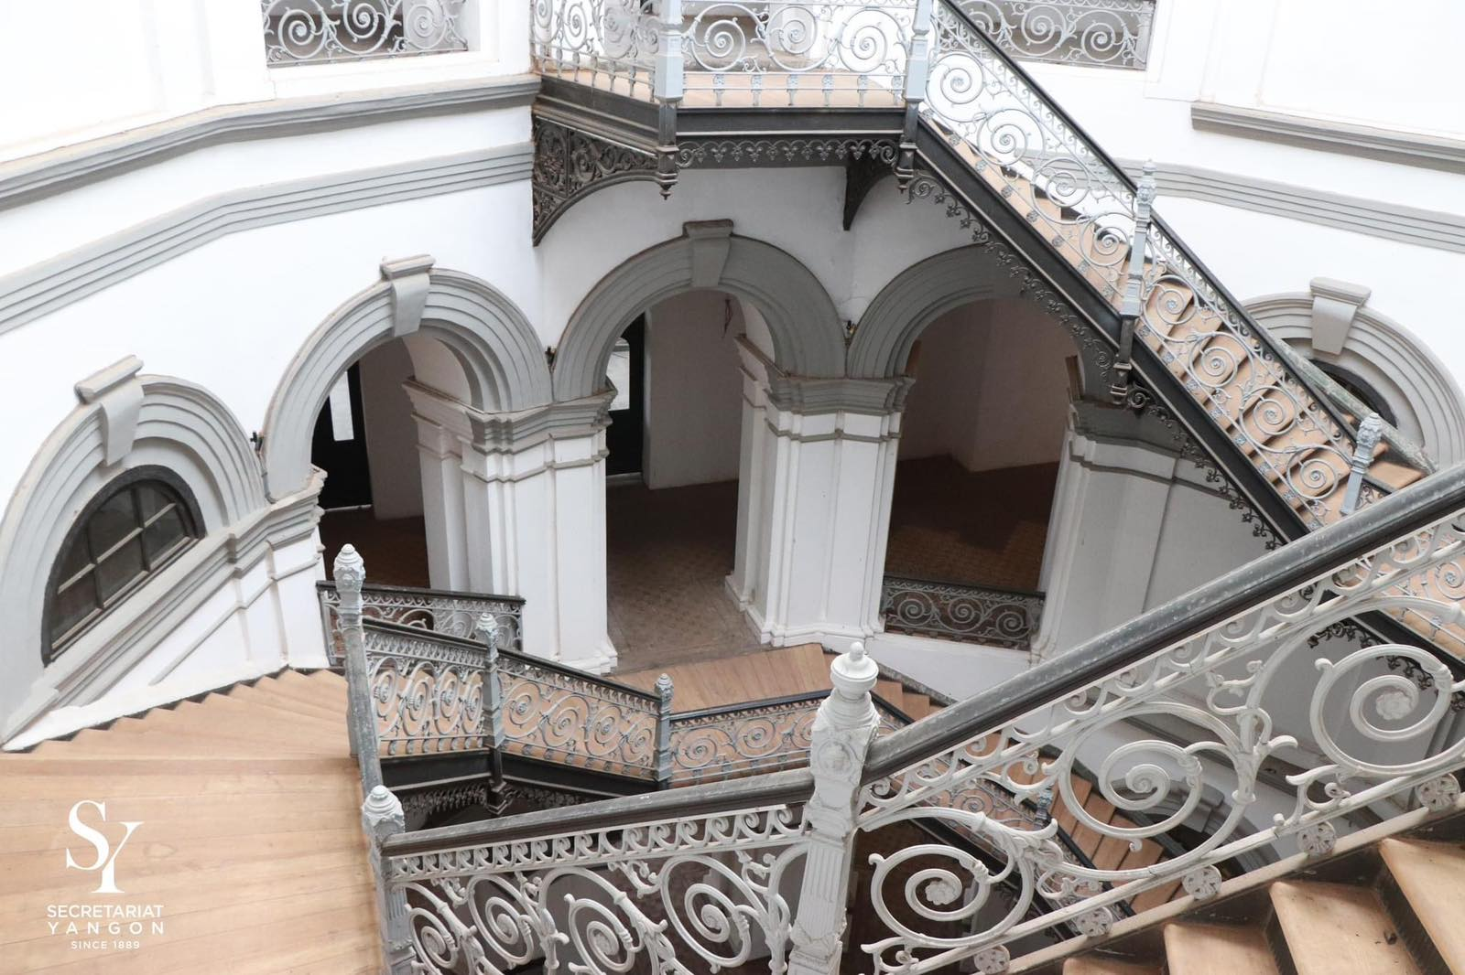
The Secretariat building is now regarded as one of the ancient buildings.
After 130 years, the building still hold the grace of the past and surviving the darkest hours that the country had been through.

Slide 12
CURRENT DAY SECRETARIAT BUILDING

Slide 13

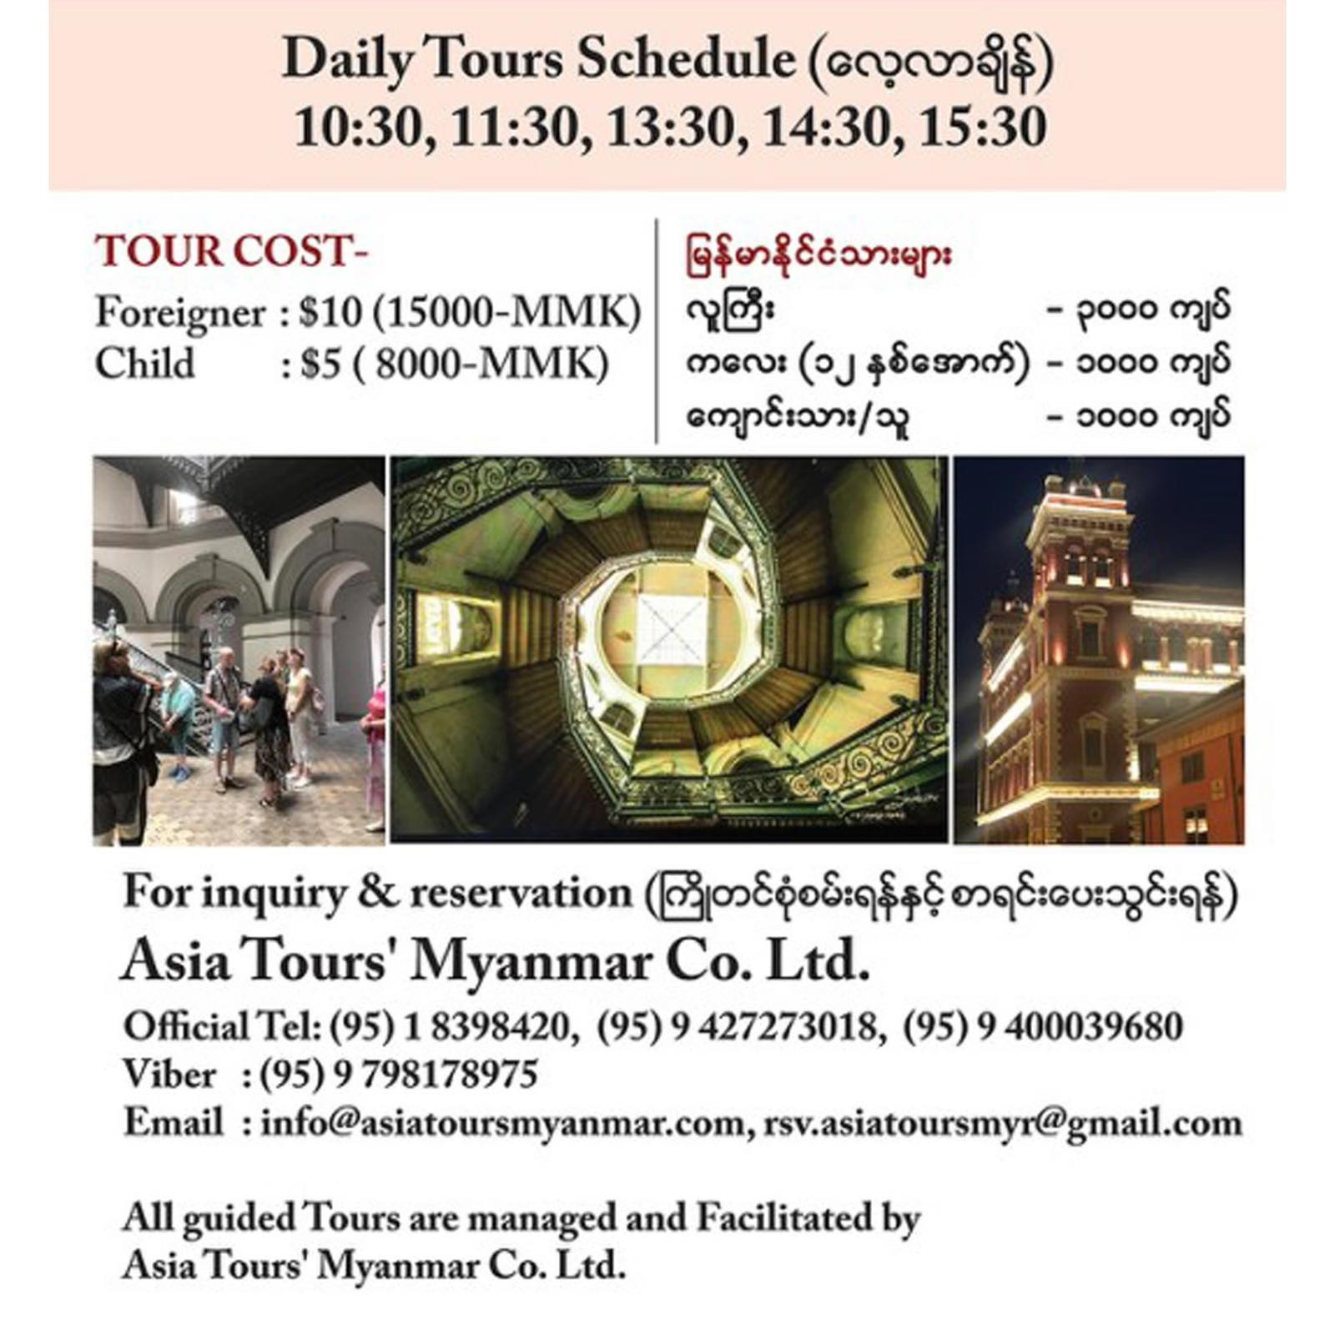

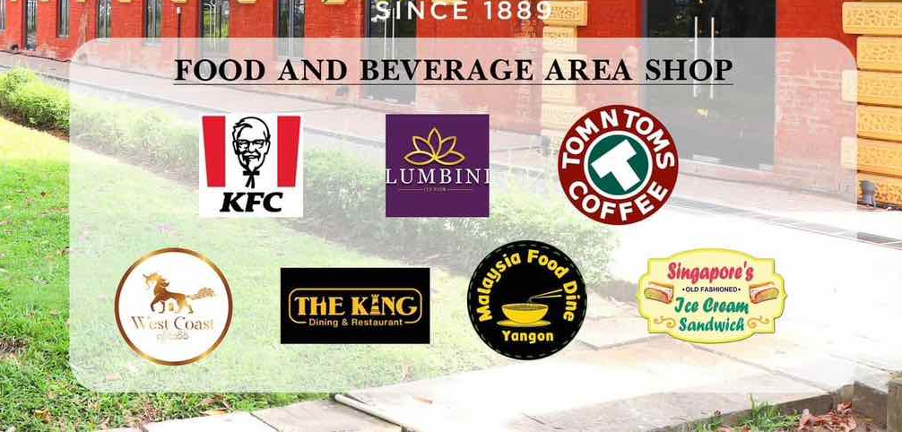
Current day Yangon
Secretariat Building
Since 2012, the building has become a mere business entity. So much history is diluted!!

Slide 14
What to RE:member?
Colonial Sentimental!
Administrative Magnificent Icon of the Leaders
Love of Architecture, Designs and Style
Investing in the Essentials
Education was epitome
Independence was both a blessing and curse:
Parliamentary: as if seed of hatred and disintegration
19th July 1947
Broken Promise of Pin Lon
Segregation of Ethnic Hill Regions vs Lowland or main Land.
Series of Coup after Coup:
Nationalization 1962
Xenophobic Culture
From Left to Right
From English to Burma-nization
1988 – 2008 Coups:
Worsening Politico-economic Conditions
Roadmap – to democrazy
History was altered and taught in schools
General Aung San became “a taboo name” in SPCD, SLOC era
Building of NPT in 2005

Slide 15
THANK YOU!

